Slide 1
Re-re-re-re-cursions
Catherine Zeng

Slide 2
Recursions
Recursions are when a certain procedure is repeated within the procedure.
For example, when two mirrors are placed facing each other, the mirror reflecting the image is reflected, reflecting the image….etc.

Slide 3
Explaining recursions with a cool story
Once upon a time, there was a man seeking enlightenment. He went to the wise man on the mountains for an advice. The wise man told him,” Once I was seeking for enlightenment too, I went to a wise man on the mountains for advice and he said,” Once I was seeking for enlightenment, I went to a wise man on the mountains for advice and he said,” Follow your heart” ” ”.

Slide 4
The algorithm of divide and conquer
The divide and conquer strategy is a very important algorithm.
It involves taking a procedure, and solving a procedure within the procedure until the base is reached. Because the base is solvable, the procedures are completed, thus solving the original.

Slide 5
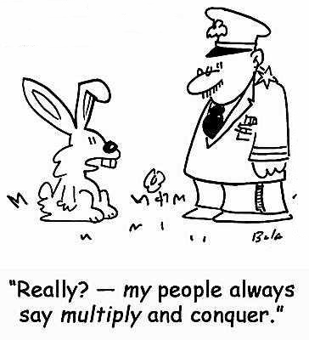
The algorithm of divide and conquer continued
For the story before,
Each wise man’s wisdom is divided up into another wise man telling wisdom until the final wisdom is reached.

Slide 6
An original recursion problem
A philharmonic. If the a piece sounds crappy, one can apply the divide and conquer strategy to listen to the entire orchestra, then the strings section, then the violins section, then each person in the violin section, and finally locate the one person who is playing out of tune. When this person is fixed, then the orchestra sounds good again.
This problem was solved by dividing the orchestra problem into sections to solve until the final problem is found

Slide 7
An original recursion problem continued
Using the SSS method:
Simplify the expression through a series of intermediate calculations until the base case is reached.
Substitute the base case in the last unsolved expression.
Solve the remaining unsolved expressions until the final answer is found.

Slide 8
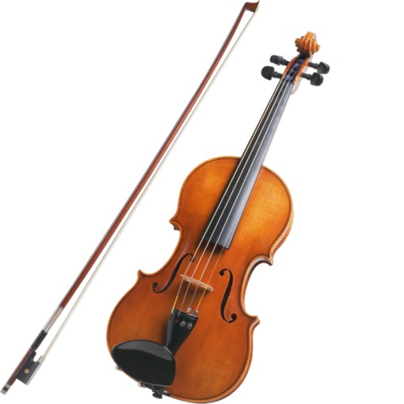
An original recursion problem continued
Using the SSS method:
Simplify the orchestra is simplified into the strings section, the violins section, and finally, the sole violinist.
Substitute Fixing the out of tune violinist fixes the violins section, strings section, and finally the orchestra.
Solve all of the sections are fixed because the violinist plays in tune now. The orchestra is “solved”

